Slide 1
Modul 3
Datamatiker
Unit og integrationstest

Slide 2
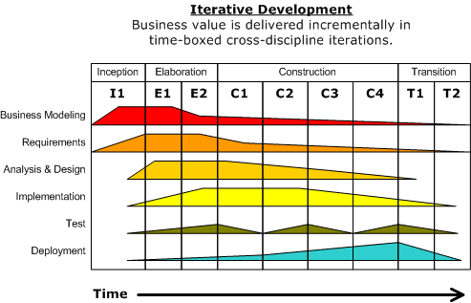
Test as Discipline in UP
Testing during all the development processes/phases
Continuosly verify quality for each artifact, activity and deliverable.
Inception: Start thinking
about how/when to test
Notes:
Test: Some initial test planning may occur during inception.

Slide 3
Syntax, Semantic, and Logic Errors
A program in Java, or C# or any other language, may contain several kinds of errors:
Syntax errors: the program may be syntactically ill-formed (missing semi-colons, brackets etc..
Semantic errors: attempt to access non-existing local variables or apply operators to the wrong type of arguments (as in true * 2, which attempts to multiply a logical value by a number)
Logical errors: the program may be syntactically well-formed and type-correct but compute the wrong answer anyway.

Slide 4
Level of Testing
An OO program should be tested at different levels to uncover all errors:
Class – Unit Testing
Single method as part of a class not in isolation
Interaction methods within a class
Set of classes - Integration Testing
Collaborations between classes
Interaction methods across classes
System – System Testing
Focus on user-visible actions and user-recognizable outputs from the system

Slide 5
Test Phases
Design
Specifications/
Interactions
diagrams
Use- Cases /
System-events
Other requirements / Quality
Use-cases
Operation
Component
test
Performance
test
Integration test
System
test
Accept test
Installation
test / Live test
Components and modules
are integrated
Full functional system with external interfaces
Verified and
validated
system
Accepted
system
Component
test
Delivered system
in use
Components
are tested
Released from development
Test of operation
5
Notes:
Which brings us to the phases and how they relate.

Slide 6
Test cases generation at system level
The most important part of a use case for generating test cases is the flow of events.
The two main parts of the flow of events are the basic flow of events (happy days scenario) and the alternate flows of events.
The alternate flows of events covers
Variations of the normal behavior
Optional behavior
Exceptional behavior (relative to the normal behavior)

Slide 7
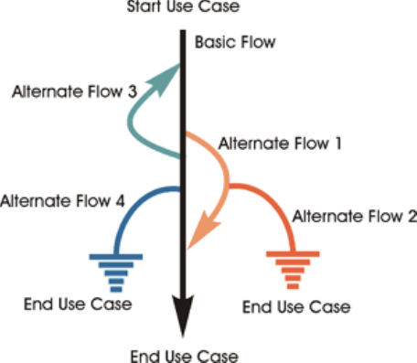
Scenario (Use case scenario)
A scenario is an instance of a use case, or a complete "path" through the use case.
E.g.
Scenario 1: Basic Flow
Scenario 2: Basic Flow, Alternate Flow 1
Scenario 3: Basic Flow, Alternate Flow 1, Alternate Flow 2

Slide 8
Generating test cases from use cases
Process for generating test cases from a fully detailed use case:
For each use case, generate a full set of scenarios.
For each scenario, identify at least one test case and the conditions that will make it "execute."
For each test case, identify the data values with which to test.

Slide 9
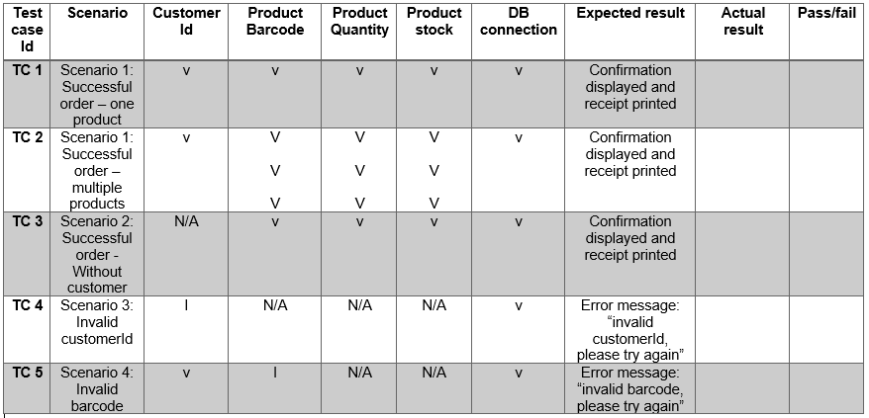
Testcase matrix - example
Example of testcase layout - unfinished version. More data and more testcases are needed to be complete.

Slide 10
Test
Blackbox – Whitebox test

Slide 11
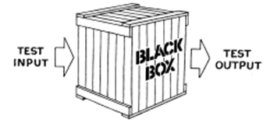
Black-box Testing
Called also:
Specification based testing
Functional testing
Tests are derived from requirements and design specifications
No reference to the components or the systems internal structure
Focus only on the inputs and outputs

Slide 12
Black-box Testing
Can be conducted at all levels
Tester constructs a ”test data set” (inputs and corresponding expected outputs)
Generation of Test Case input is difficult
Need clear requirements / specification
One must carefully consider what inputs might reveal problems in the program, and use exactly those, not create a large collection of input data sets “just to be on the safe side”
Effective testing means right strategy for generating appropriate set of Test Cases.

Slide 13
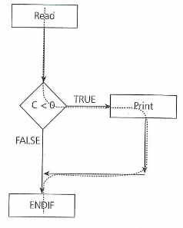
Whitebox Test
Know the structure or system code
100% coverage means that the test comes through all paths in the program
All logical pathways (eg if-statements) are evaluated to be both true and false
The coverage rate is measured based on actual passages in relation to possible
Typically automated tools and analysis tools are used

Slide 14
Test
Ækvivalente klasser

Slide 15
Equivalence Class Partitioning and Boundary Value Testing
Black-box Testing: Equivalence Class Partitioning and Boundary Value Testing
Black-box testing
Often it is impossible to create Test Cases for all input values
Used to reduce the total number of Test Cases to a finite set of testable Test Cases, still covering maximum requirements
How do we do that?

Slide 16
Black-box Testing: Equivalence Class Partitioning and Boundary Value Testing
Black-box Testing: Equivalence Class Partitioning and Boundary Value Testing
The role of Equivalence Class Partitioning and Boundary Value Testing
Create the minimum number of Black Box Tests needed while still providing adequate coverage
Steps
Identify Equivalence Classes – the input ranges which are treated the same by the software
Valid classes: legal input ranges
Invalid classes: illegal or out of range input values
Test Cases at the boundary of each Equivalence Class (if numeric)
Just below the boundary
Just above the boundary
Invalid
Valid
Invalid

Slide 17
Equivalence Class
ECs are subsets of input data, where testing any one value in the set should be the same as testing the others.
Example: UI with just two fields for creating a user account. Username can be between 1 and 25 characters but can’t contain a space. Sex can be either Male or Female
(Equivalence class - explanation).

Slide 18

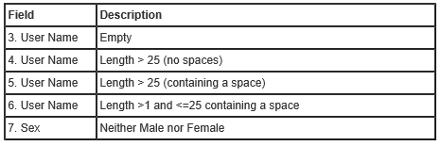
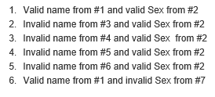
Equivalence Class – Example (continued)
User Name can be between 1 and 25 characters, but can’t contain a space. Sex can be either Male or Female.
Two ECs
Peter/Male, Mary/Female, Tom/Male…
Also consider invalid input (invalid ECs):
Notes:
When designing your tests, it’s important to only pick one invalid value per test case; using more than one can lead to missed product bugs. Suppose you choose a test with both an invalid User Name and an invalid Sex. The product may throw an error when it detects the invalid User Name, and never even get to the logic that validates the Sex. If there are bugs in the Sex-validation logic, your test won’t catch it.

Slide 19
Positive vs Negative Test Cases
Positive : Test with valid data
Negative : Test with invalid data

Slide 20
Test
Unittest

Slide 21
Unit Test – in OO
Focus verification effort on the smallest unit of software design: The Class
A Class is usually the focus of Unit Testing
Test the single methods separately (usually expensive due to the scaffolding)
Test the methods in the context of the class they belong to
Both Black-box and White-box testing techniques can be applied

Slide 22

How it feels when you start doing unit tests

Slide 23
Test Scaffolding
Scaffolding: Additional code not as part of the application but written simply to support the process of Unit and Integration testing.
Drivers: code that calls the module being tested
E.g. JUnit
Stubs: Code that simulates the behaviors of modules (not yet implemented) that the module under test depends on, so that it can be executed

Slide 24
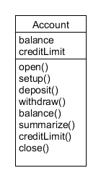
Example of Method Testing (BankAccountTesting)
Method: public boolean withdraw (double amount)
Rules:
Amount only allowed to be redrawn if balance is positive or 0 after the redraw.
Maximum amount to be redrawn is 15.000 kr. Minimum is 10 kr.
Equivalence Classes:
Balance:
Withdraw amount:
0
Invalid
Valid
10
15.000
Invalid
Valid
Invalid
Expected result
Ok , balance reduced with amount
Rejected, balance unchanged

Slide 25
Example of Method Testing in the Context of the Class
Define Test Cases with basis in Equivalence Classes and Boundary Values:
No | Balance before redraw (kr) | Redrawn amount (kr) | Expected result
1 | 3000 | 3000 | True, balance = 0
2 | 3000 | 3001 | False, balance = 3000
3 | 3000 | 10 | True, balance = 2990
4 | 3000 | 9 | False, balance = 3000
5 | 16.000 | 15.000 | True, balance = 1000
6 | 16.000 | 15.001 | False, balance = 16.000
7 | 15.000 | 15.001 | False, Balance = 15.000
Notes:
Balance 3000: Boundary around 3000 (only allowed to redraw 3000). Test around boundary.

Slide 26
Junit – write good unit test
Small specific test methods (do one thing)
Test method name indicates expected result
Keep Junit tests very simple
Know equivalence classes
Use the AAA pattern
Arrange
Act
Assert

Slide 27
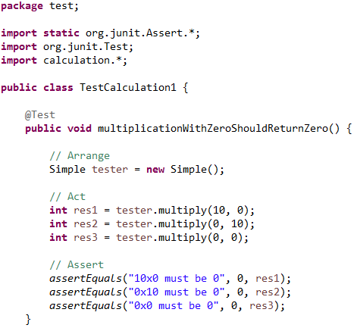
Junit – AAA Pattern

Slide 28
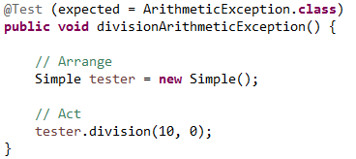
Junit 4.x – test of exceptions

Slide 29
Junit 4.x - annotations
Source: www.vogella.com/tutorials/JUnit/article.html#juniteclipse
Annotation | Description
@Test public void method() | The @Test annotation identifies a method as a test method.
@Test (expected = Exception.class) | Fails if the method does not throw the named exception.
@Test(timeout=100) | Fails if the method takes longer than 100 milliseconds.
@Before public void method() | This method is executed before each test. It is used to prepare the test environment (e.g., read input data, initialize the class).
@After public void method() | This method is executed after each test. It is used to cleanup the test environment (e.g., delete temporary data, restore defaults). It can also save memory by cleaning up expensive memory structures.
@BeforeClass public static void method() | This method is executed once, before the start of all tests. It is used to perform time intensive activities, for example, to connect to a database. Methods marked with this annotation need to be defined as static to work with JUnit.
@AfterClass public static void method() | This method is executed once, after all tests have been finished. It is used to perform clean-up activities, for example, to disconnect from a database. Methods annotated with this annotation need to be defined as static to work with JUnit.
@Ignore or @Ignore("Why disabled") | Ignores the test method. This is useful when the underlying code has been changed and the test case has not yet been adapted. Or if the execution time of this test is too long to be included. It is best practice to provide the optional description, why the test is disabled.

Slide 30
Junit 4.x – assert methods
Statement | Description
fail(message) | Let the method fail. Might be used to check that a certain part of the code is not reached or to have a failing test before the test code is implemented. The message parameter is optional.
assertTrue([message,] boolean condition) | Checks that the boolean condition is true.
assertFalse([message,] boolean condition) | Checks that the boolean condition is false.
assertEquals([message,] expected, actual) | Tests that two values are the same. Note: for arrays the reference is checked not the content of the arrays.
assertEquals([message,] expected, actual, tolerance) | Test that float or double values match. The tolerance is the number of decimals which must be the same.
assertNull([message,] object) | Checks that the object is null.
assertNotNull([message,] object) | Checks that the object is not null.
assertSame([message,] expected, actual) | Checks that both variables refer to the same object.
assertNotSame([message,] expected, actual) | Checks that both variables refer to different objects.

Slide 31
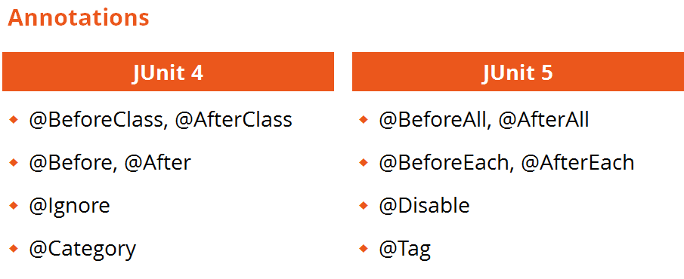
https://junit.org/junit5/docs/current/api/org.junit.jupiter.api/org/junit/jupiter/api/Assertions.html

Slide 32
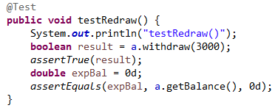
Test in Junit for public boolean redraw(double amount)
[Code]
public class Account {
private double balance;
public Account(double startBal)
{
balance = startBal;
}
public boolean redraw(double amount)
{
boolean retValue = false
if (amount<=balance)
{
balance=balance-amount;
retValue = true;
}
return retValue;
}
public double getBalance()
{
return balance;
}
}
Notes:
In class AccountTest
0.0

Slide 33
Øvelse

Slide 34
Modul_3_Exercise
Exercise 1
Write the code for all the other test cases in the table on slide 18
If finished before time continue the unit testing by addressing depost, tranfer etc.

Slide 35
Test
Integrationstest

Slide 36
Dependencies
In ideal conditions a Unit Test should test in isolation the class under test, but …What if the method depends on methods from other classes?
Use stubs
Do Integration Test
Notes:
However defined, a unit is tested “by itself,” with adjacent software units being replaced by stubs and drivers to emulate inputs and outputs.
The goal of unit testing is to verify that, taken by itself, the unit functions correctly. (Another view is to see how the unit functions, assuming everything else is perfect.)

Slide 37
Method Sequence
An OO application consists of a set of class instances (objects) interacting with one another by invoking methods.
The sequence in which each object invokes its methods is important for the proper functioning of the object.
The sequence is documented in the interaction diagrams

Slide 38
Integration Testing
Activity of exercising integration between different units composing a system.
Usually the units are developed by different programmers.
Integration Test Cases focus more on the interfaces and flow of data/information between modules.
This makes sense as unit testing have already been completed before integration

Slide 39
Integration Test
Typical errors found:
A method has a wrong data type for a parameter compared to another method
A method returns an unexpected value
Run time exceptions
Situation where objects interacts correct except for one object
Interface problems
Missing functionalities
Side-effect
The caller have a different order of parameters than the method used

Slide 40
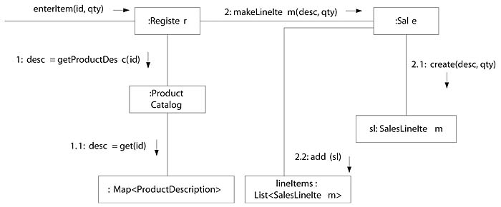
Integration Test in OO
Use subsequences of the Interaction Diagrams
For example, we consider the sequence numbered 2 and we test the method makeLineitem together with create and add

Slide 41
Integration Test in OO - Recap
Based on UML Interaction Diagrams
Pick a particular path in the diagram and “drive” the objects through that path
Run tests that cover all diagrams, and critical message paths and conditions inside each diagram
Normal scenarios
Alternatives

Slide 42
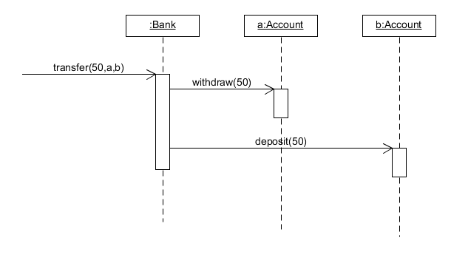
Example: Integration Testing

Slide 43
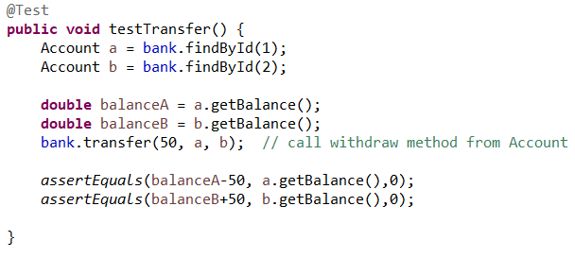
Example cont. : Integration Testing
Notes:
Test Class BankTest

Slide 44
Drivers and Stubs
A Test Driver is a method that performs the test (run)
A Stub simulates an unimplemented method; consists of method signature and a hard-coded return value
In the JUnit framework, Test Drivers are generated
Good article

Slide 45
Terminology
Driver – method/class responsible for initiating the test. This could be the test framework itself.
Stub – temporary substitution of underlying methods/classes. The purpose it to isolate a single method.
Direct output – the direct return value of a method.
Indirect output – the output the method is sending to underlying methods

Slide 46
Call Hierarchy
Method1()
Method2()
Method4()
Method5()
Method3()
Method6()

Slide 47
Testing with drivers and stubs
Method1()
Method2()
Method4()
Method5()
Method3()
Method6()
Testing the Method1() requires us to use a Driver to initialize the method (call it).
The driver, in test scenarios, will typically be a unit testing framework like Junit.
To prevent the result of Method2() and Method3() to contaminate the result in Method 1. We can insert a stub instead of them.
Using stubs allows us to focus on the single method under test.

Slide 48

Testing with drivers and NO stubs
Method1()
Method2()
Method4()
Method5()
Method3()
Method6()
Invoke / call
Driver (the Stig)

Slide 49
Testing with drivers AND stubs
Method1()
Method2() – the stub
Method3() – the stub
Invoke / call
Driver (the Stig)

Slide 50
Example of a Driver
Method for calling of Constructor “CreateProduct”
Junit Test Method
public void setUp()
{
Product p1 =new Product(1,”cowboyhat”, 100,50);
}
@Test
public void testProduct()
{
assertEquals(1, p1.getId());
assertEquals(”cowboyhat”, p1.getDescription());
assertEquals(100, p1.getPrice());
assertEquals(50, p1.getNoInStock());
}

Slide 51
Example of a Stub
Simulate method in Product Class
Int getId()
{
// stub method for Product:: getId()
return (1);
}
String getDescription();
{
//stub Method for Description::getDescription()
return (”cowboyhat”)
}

Slide 52
Integration Test Strategy
Database testing from the DB layer classes
Test methods would create and retrieve entries from the database
In the tearDown() method delete all the data from tables.
Integration Control Layer with the Model and DB layer
Use stubs if you do not want to integrate the DB
Integration GUI with the Control Layer

Slide 53
Øvelse

Slide 54
Modul_3_Exercises
Exercise 2

Slide 55
Test
perspektiver

Slide 56
Regression testing
Regression testing
Often new errors are coded into the systems when you correct errors (1 new error per 4 bugs fixed) especially when you are in a hurry.
When the correction of errors are characterized by stress and / or insufficient knowledge of the code, the components and the whole system, the risk for introducing new errors are very high.
When you have made changes to the code, all tests should be run again! This is called regression test.

Slide 57
Debugging
What to do when testing discovered faults?
Debugging: determine the cause of an error and remove the fault
Fault localization
Fault removal

Slide 58
Test Utopia
To verify an IT system, ideally all paths should be tested with all variations of data
This is not realistic within the frames of time and financial resources!
Test wisely:
Use test design techniques with proven value
Select input data wisely (equivalence classes and boundary values)

Slide 59
Test Plan
Plan of the test should be defined within the scope of the iteration – together with the other activities for quality assurance
Item to be tested
Approach to be taken
Resouces
Deliverables
Test is an investment. You have a limited amount of money and must deliver the best value possible by making and executing a good test plan

Slide 60
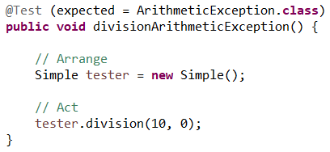
Issues with OO Testing: Exceptions in JUnit 4.x

Slide 61
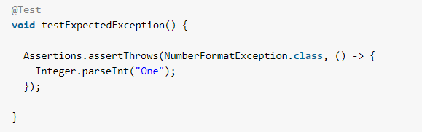
Issues with OO Testing: Exceptions in JUnit 5.x
For more information about Junit 5: https://www.vogella.com/tutorials/JUnit/article.html
Notes:
-> Arrow Operator used in Lambda expression

